Slide 1
Font: Calibri
Title Point Size: 60
If point size decreases
or if title is long, use next template.
Name Point Size: 24
Title of Presentation
John Doe, title, company if different than Gateway

Slide 2
Font: Calibri
Title Point Size: 60
If point size decreases, simplify title and use subtitle text box (see next slide)
Name Point Size: 24
Title Slide for Longer Presentation Names
John Doe, title, company if different than Gateway

Slide 3
Title Slide for Presentations
that Need Subtitle
Font: Calibri
Title Point Size: 54
Subtitle Point Size: 32
Name Point Size: 24
Subtitle Here
John Doe, title, company if different than Gateway

Slide 4
Slide heading in sentence case
(not initial cap or all caps)
Supporting points here
In sentence case
  Use for secondary messaging points
Don’t feel like you have to cram all your points on a slide
Less is best

Slide 5
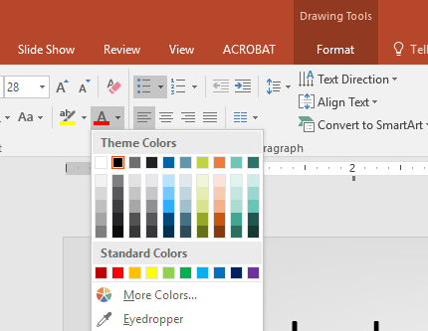
Brand colors
Use these Theme Colors for charts, etc.

Slide 6
Break slides follow
Use these to break up the topics of your presentation
If your presentation is simple, don’t feel like you have
to use these pages

Slide 12
Font: Calibri
Point Size: 32
Presenter Name
email@gatewayticketing.com
+1 610-473-_ _ _ _

